Slide 1





Performance analysis and optimization
MAQAO Tool
Andrés S. CHARIF-RUBIAL
achar@exascale-computing.com
Exascale Computing Research
08/02/2012 – Fréjus – Ecole d’optimisation

Slide 2
Outline
Introduction
Methodology
MAQAO Tool and Framework
Static Analysis
Dynamic Analysis
Conclusion

Slide 3
Introduction
Pareto principle : in software engineering 90/10
Programmer view ≠ architecture impact
Amdahl’s law : evaluate sequential part
Optimisation cost : code quality
Optimisation target : execution time
Binary VS Source level
Compiler is your best friend

Slide 4
Methodology
Systematic Workflow
Define a goal : walltime, memory, scalability
Consider target application
What we are using / Which accuracy
Static + Dynamic approach

Slide 5
Methodology
Type of code ? CPU or memory bound
Approach : Top-Down / Iterative
Detect hot spots
Focus on specific parts

Slide 6
Methodology
Exploit Compiler to the maximum
  IPO and inlining !!!
  Flags
  Optimization levels
  Pragmas : unroll,vectorize
  Intrinsics
  Structured code (compiler sensitive)

Slide 7
MAQAO Tool and Framework
MAQAO Framework
  Modular approach
  Reusable components
MAQAO Tool
  Using Framework
  User feedback
  User interface
  Batch interface

Slide 8
MAQAO Framework
Binary manipulation
Set of C libraries (core features)
Scripting language on top
Plugins

Slide 9
MAQAO Framework
MADRAS
Abstraction layer
Disassembler
Generator
Disassemble
libmadras
libcore
libcommon
libasm
Re-assemble
Patch/Rewrite
libaffine
libmt
MAQAO Lua Plugins
API bindings to Abstract And Binary layers
DECAN
STAN
MIL
…
DDG
MTL
MAQAO Profiler

Slide 10
MAQAO Tool
Built on top of the Framework
Exploit existing framework features
Produce reports
Client/Server approach
  User interface
  Batch interface
Loop-centric approach
Packaging : ONE (static) standalone binary

Slide 11

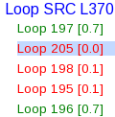
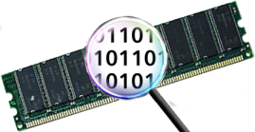
MAQAO Tool overview
Modular Assembler Quality Analyzer and Optimizer
www.maqao.org
Assembly code / (innermost) Loops
Code abstraction
Assembly code
Binary code
CFG
MADRAS
CG
Dominator tree
DDG
Loop detection
Compiler
Dynamic
Analyses
Reports
Source code
Static
Runtime
End User
Developer
External
Developers
=> New modules
Notes:
Provide user with hints and expose gathered data if no feedback is available

Slide 12
MAQAO Tool
Web User interface
SCREENSHOT HERE

Slide 13
Static analysis
Static performance model : STAN
  Loop-centric
  Predict performance
  Take into account microarchitecture
  Asses code quality
    Degree of vectorization
    Impact on micro architecture

Slide 14
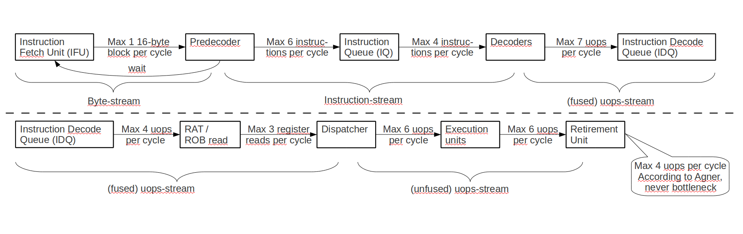
Static analysis
Core2 Pipeline Model
IQ can be used as a MIN (64 bytes, 18 instructions) loop buffer

Slide 15
Static analysis
NHM Pipeline Model
IDQ can be used as a MIN (256 bytes, 28 uops) loop buffer

Slide 16
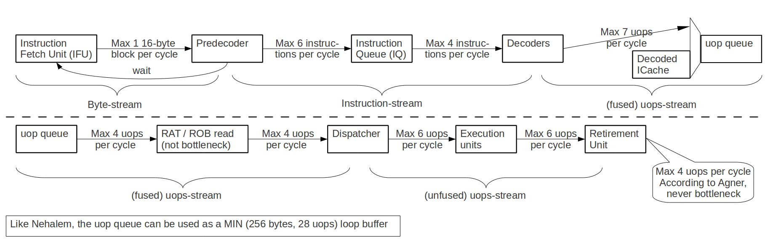
Static analysis
Sandy Bridge Pipeline Model
New !
16 bytes fetched / cycle, ~ 3 SSE / AVX instructions per cycle
4 instructions decoded per cycle...
uop queue can be dynamically reconfigured as loop buffer
1.5 Kuops cache (100% hits for hotspots and 80% hits avg.)

Slide 17
Static analysis
How can this help me ?
  Architecture bottlenecks
  Control unrolling impact
  Data precision and divison : Newton-Raphson
    Only applies on single precision
    Faster to compute 1/x and 1/√x (RCP and RSQRT)
    From ≈30-60 cyles to a few cycles (≈6cyles)

Slide 18
Static analysis
How can this help me ?
  Major improvement lever : vectorization
  Is code vectorized ?
  How well is it vectorized ?
  Guide compiler with pragmas

Slide 19
Static analysis
Report Example
********************************************************
PROCESSING LOOP 2421
********************************************************
Function: sparse_full_mm5_
Source file: /mnt/nfs/eoseret/qmc_chem/QmcChem_new/src/IRPF90_temp/
mo.irp.F90
Source line: 2121-2126
Address in the binary: 5540a0
********************************************************
GENERAL LOOP PROPERTIES
********************************************************
nb instructions : 19
nb uops : 19
loop length : 120
used xmm registers : 0
used ymm registers : 15
nb FP arithmetical operations:
add-sub 40
mul 40
Ratio ADD-SUB/MUL (instructions): 1
Bytes loaded: 192
Bytes stored: 160
Arith. intensity (FLOP / ld+st bytes): 0.23
FIT IN UOP CACHE
********************************************************
EXECUTION PORTS _ OPTIMAL METHOD
********************************************************
10.00 cycles
********************************************************
DISPATCH
********************************************************
P0 P1 P2 P3 P4 P5
uops 5.00 5.00 5.50 5.50 5.00 3.00
cycles 5.00 5.00 6.00 6.00 10.00 3.00
********************************************************
VECTORIZATION RATIOS
********************************************************
all : 100%
load : 100%
store : 100%
mul : 100%
add_sub : 100%
other = NA (no other SSE or AVX instructions)
********************************************************
IF ALL DATA IN L1
********************************************************
cycles: 10.00
FP operations per cycle: 8.00 (GFLOPS at 1 GHz)
instructions per cycle: 1.90
bytes loaded per cycle: 19.20 (GB/s at 1 GHz)
bytes stored per cycle: 16.00 (GB/s at 1 GHz)
bytes loaded or stored per cycle: 35.20 (GB/s at 1 GHz)
Cycles executing div or sqrt instructions: NA
********************************************************

Slide 20
Dynamic analysis
Static analysis is optimistic
  Data in L1$
  Believe architecture
Get a real image
  Coarse grain : find hotspots (MAQAO profiler)
  DECAN : compute / memory bound
  MIL : specilized instrumentation
  MTL : characterize memory behavior

Slide 21
MAQAO profiler
Method : Sampling VS Tracing
Tradeoff : accuracy VS execution time
New method : minimizing callsite Instrumentation
Loop level : filtering compared to ICC
Handles OpenMP codes

Slide 22
MIL : Instrumentation Language
Why ? Yet another language ?
  Need to handle coarse and fine grain issues
  Tool to express such queries
  DSL : Sufficiently rich for instrumentation purposes
  Fast prototyping
  Focus on what (research) and not how (technical)
  Explore code properties (side effect)
  What about OpenMP/MPI ?

Slide 23
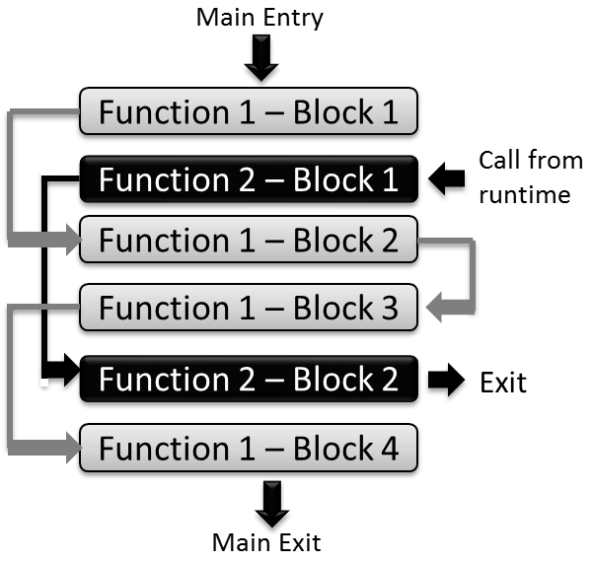
MIL : Instrumentation Language
Handling interleaved functions
  Example
  Connected components approach (static analysis)

Slide 24
MIL : Instrumentation Language
Handling masked exits
  Unconditional jumps to other functions
  Jumps pointing on returns
  Indirect jumps
  Exit handlers list

Slide 25
MIL : Instrumentation Language
Gobal variables
Events
Filters
Actions
Configuration features
  Output
  Language behavior (properties)

Slide 26

MIL : Instrumentation Language
Probes
  External functions
    Name
    Library
    Parameters : int,strings,macros,cstring
    Return value
    Demangling
    Context saving
  ASM inline : handles loops
_ZN3MPI4CommC2Ev
MPI::Comm::Comm()

Slide 27
MIL : Instrumentation Language
Events
  Program : Entry/Exit (avoid LD + exit handlers)
  Functions : Entries/Exists
  Callsites : Before/After
  Loops : Entries/Exists/Backedge
  Blocks : Entries/Exists
  Instructions : Address

Slide 28
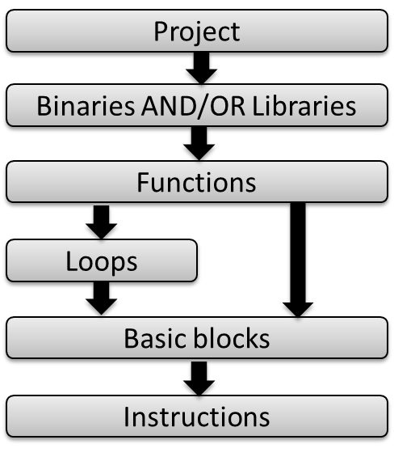
MIL : Instrumentation Language
Events : Hierarchical evaluation

Slide 29
MIL : Instrumentation Language
Filters
  Why ?
  Lists : whitelist / blacklist (int,string,regexp)
  Built-in : structural properties attributes (nesting level for a loop)
  User defined : an actions that returns true/false

Slide 30
MIL : Instrumentation Language
Actions
  Why ?
  Scripting ability
  Function : current object (this) and patcher
  Access to MAQAO Plugins API
  User filters may be used to express very complex constraints

Slide 31
MIL : Instrumentation Language
Another way to use the MAQAO Framework :
DSL for Building performance evaluation tools
Instrumentation File
Binaries | Probes | Target Events | Filters |Actions
MIL
Process file
MADRAS
Disassembler
Hierarchical Events
Abstract Layer
Evaluate filters
MAQAO
Plugins
API
Probes
Actions
MADRAS
Assembler And Rewritter
MAQAO
Framework
Instrumented Binary(ies)

Slide 32
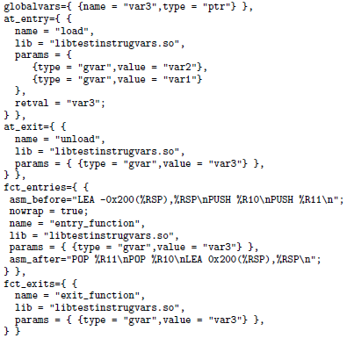
MIL : Instrumentation Language
Example 1

Slide 33
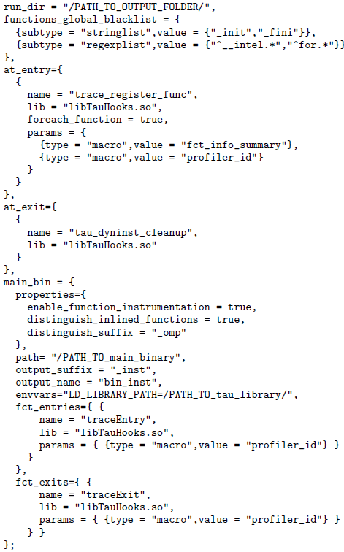
MIL : Instrumentation Language
Example 2

Slide 34
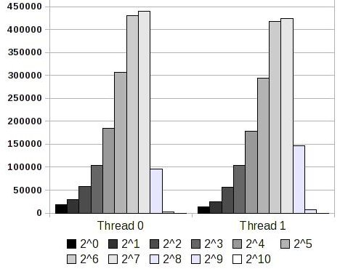
MIL : Instrumentation Language
Use case 1 : Loop value profiling

Slide 35
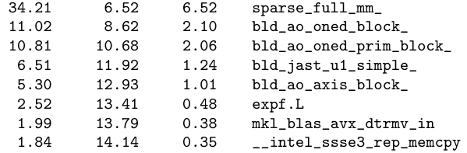
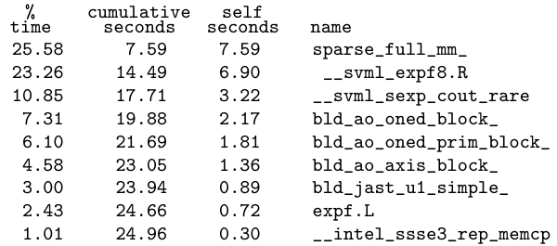
MIL : Instrumentation Language
Use case 2 : Function value profiling
Before
After

Slide 36
MIL : Instrumentation Language
Use case 3 : timing short loops
3 most time consuming loops : 224 cycles (QMC==Chem)
Probe accuracy
Compensation | Without | With
MAQAO | 134653 * 106 | 126273 * 106
IFORT | - | 135486 * 106
Instrumentation overhead
 | Original | MAQAO light | IFORT light
Walltime | 97 s | 101 s | 112 s
Overhead | - | 4 % | 15 %

Slide 37
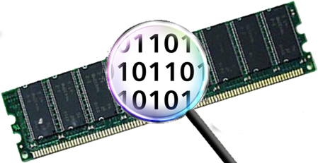
MTL : Memory Trace Library
Characterizing the memory behavior of an application

Slide 38
MTL : Target
  Characterize memory behavior (memory bound code)
  Complex Shared memory environment : CC-NUMA / NUCA
  Architecture specs: Prefetch, PLRU
  Scaling issues
  Multithread : OpenMP
  Loop centric approach
  Capture behavior of memory access : tracing
    Time
    Space

Slide 39
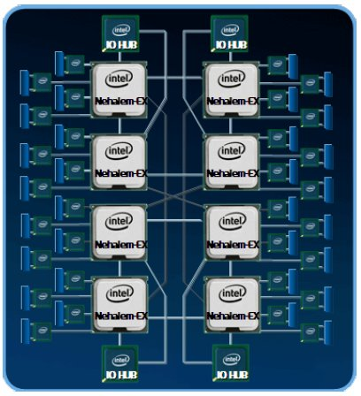
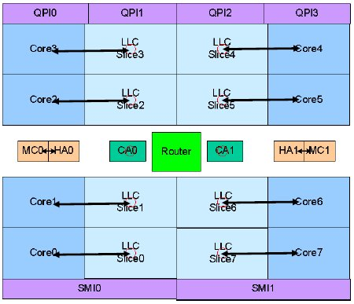
MTL : Target
Complex shared memory environments : CC-NUMA / NUCA

Slide 40
MTL : Motivation
NPB and Spec OMP 2001
Benchmark | Reference |  | Best / Close | Gain
 | WTime (s) | Threads | WTime (s)
NPB CG.A | 0.62 | 96 | 0.42 | 32%
NPB MG.A | 3.10 | 96 | 1.88 | 40%
NPB FT.A | 2.29 | 96 | 1.47 | 35%
SOMP 324.fma3d_m R | 117.76 | 40 | 119.15 | -1%
SOMP 320.mgrid_m R | 111.14 | 40 | 84.71 | 24%
SOMP 312.swim_m R | 122.63 | 40 | 79.22 | 35%

Slide 41
MTL : Metrics
Help user understanding memory related issues
Alignement issues
  Data
  Architecture
Access Pattern issues
Data sharing : reuse, false sharing

Slide 42
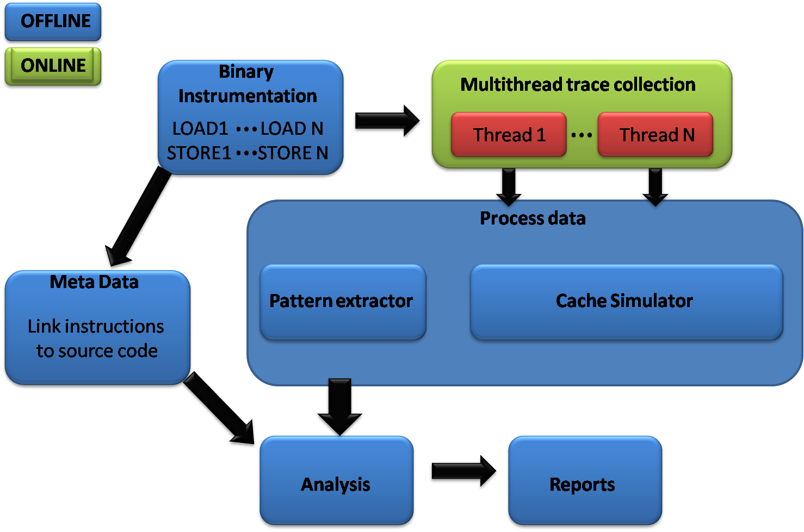
Memory Traces: overview
Infrastructure

Slide 43
Trace collection
Trace collection
  Per thread – per instruction
  Target instructions: memory operations
  Using NLR
  Instrumentation time and space consumption

Slide 44
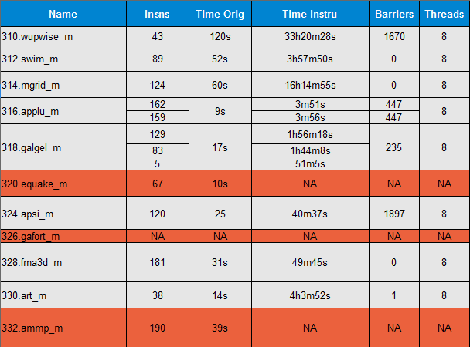
Trace collection : instrumentation
Blind method : full instrumentation

Slide 45
Trace collection : enhancement
Finer method : strength reduction algorithm
  Find loop invariants (registers and stack values);
  Find induction variables (affine expressions only, since the trace has only Z-polytopes)
  Find all memory accesses based on induction variables and loop invariants;
  Instrument all loop invariants and all memory accesses that are not built based on induction variables and loop invariants.
  Reconstruct address flows and Z-polytopes (NLR)

Slide 46
Trace collection : enhancement
Finer method : strength reduction algorithm
Benchmark | Ref | Instru | Overhead
SOMP 312.swim_m | 2m56s | 3m03s | 0.04x
SOMP 314.mgrid_m | 4m03s | 37m56s | 8.36x
NAS PB cg.B | 17s | 35m29s | 58.88x
NAS PB ft.B | 11s | 1h04m10s | 349x

Slide 47
MTL Metrics: Data alignment
Architecture : Even if vectors aligned => up to 10 cycles penalty
Micro benchmarking
Look for (poor) know patterns
Change code : Reduce stores

Slide 48
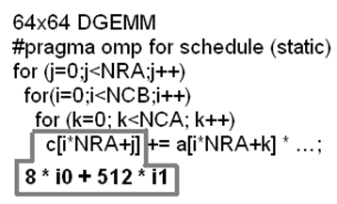
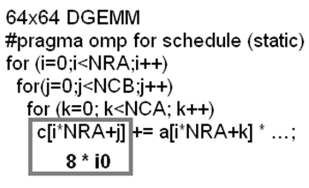
MTL Metrics : Access patterns
Inefficient patterns
On nested loops, loop interchange can improve spatial locality for strided accesses (column major, row major).
The left access pattern uses 512 Bytes strides (one element out of 8) which decreases spatial locality.
This transformation is suggested to the user only if it enhances locality (according to the cost function)
Notes:
Example of inefficient access pattern
Evoke cost function => no gain
Actually transposition is the solution

Slide 49
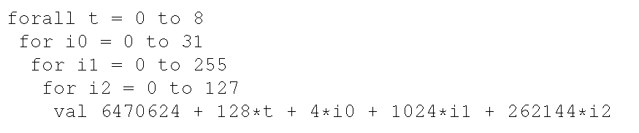
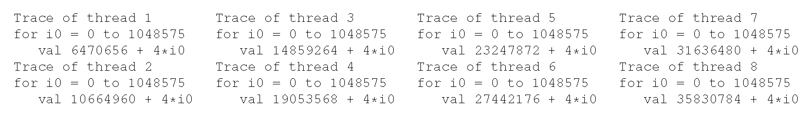
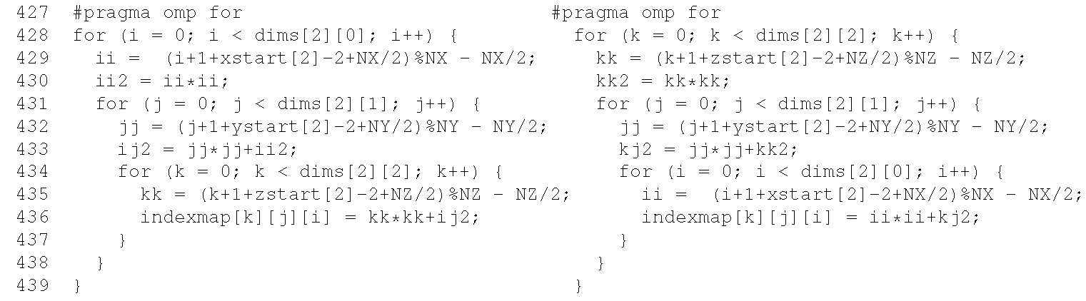
MTL Metrics : Access patterns
Loop interchange : NPB 2.3 C example
Before
After
  Hardware prefetch can’t work
  DTLB Misses
5% Gain

Slide 50
MTL Metrics : Access patterns
Data Layout : Splitting
Single FP array
Red and Black checkboard example
DO IDO=1,NREDD
INC = INDINR(IDO)
HANB = AM(INC,1)*PHI(INC+1) &
+ AM(INC,2)*PHI(INC-1) &
+ AM(INC,3)*PHI(INC+INPD) &
+ AM(INC,4)*PHI(INC-INPD) &
+ AM(INC,5)*PHI(INC+NIJ) &
+ AM(INC,6)*PHI(INC-NIJ) &
+ SU(INC)
DLTPHI = UREL*( HANB/AM(INC,7) - PHI(INC) )
PHI(INC) = PHI(INC) + DLTPHI
RESI = RESI + ABS(DLTPHI)
RSUM = RSUM + ABS(PHI(INC))
ENDDO)
Inefficient pattern : stride 2 access detected on whole structure (FILE:SRC LINE)
=> You may consider splitting your data structure
Reading 1 element out of 2 (wasting spatial locality)
30% Gain

Slide 51
Enhancing parallelism : overview
Memory behavior characterization
  Shared resources between cores
  Take into account architectural and OS mechanisms
  Find out interactions between threads : Z-Polytopes intersection
  Our approach : use a simplified cache simulator
    Intersection on a cache line basis
    Information on instructions and threads
    Finer categorization of interactions : load/load load/store store/store
    Affinity graph
    Project affinity graph on a target architecture
  Provide users at source level with reports dealing with memory behavior characterization based on metrics:
    Load balancing
    Data sharing : reuse and false sharing
Affinity

Slide 52
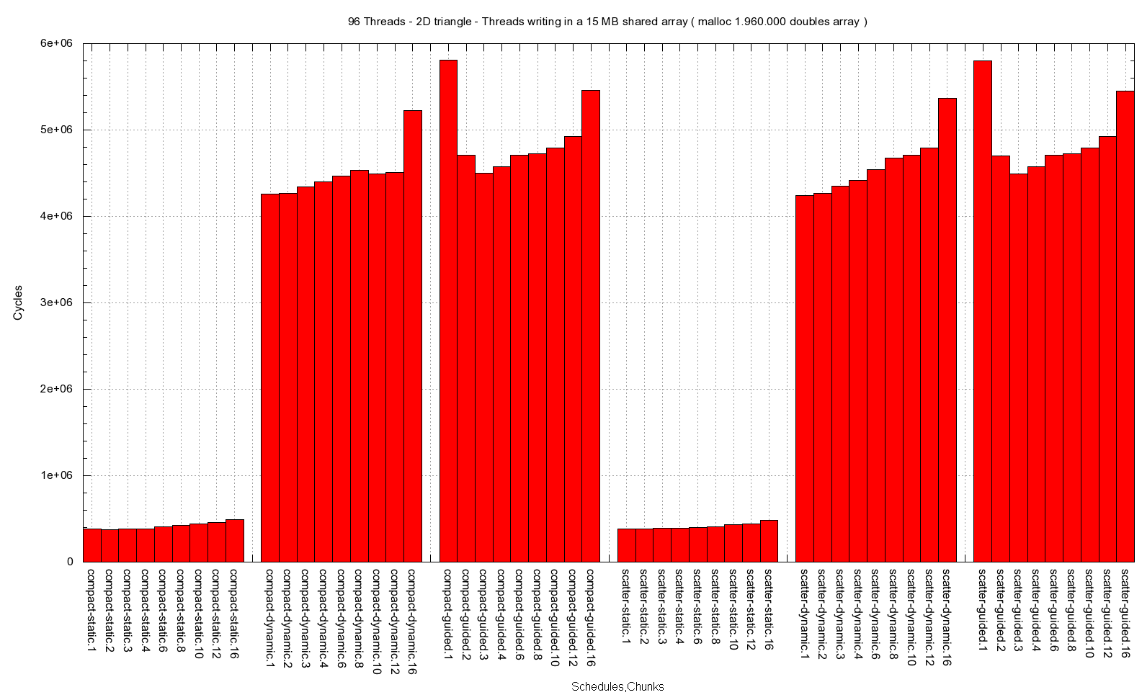
Enhancing parallelism :
Load balancing
Load balancing
We evaluate load balancing based on the percentage of memory accesses (of the threads).
OpenMP strategies : In most cases the static scheduling is the best performing strategy. It is also important to set the thread affinity.
Triangle traversal execution time.
From left to right :
Compact, Scatter
Static, Dynamic,guided
1,2,3,4,6,8,10,12,16

Slide 53
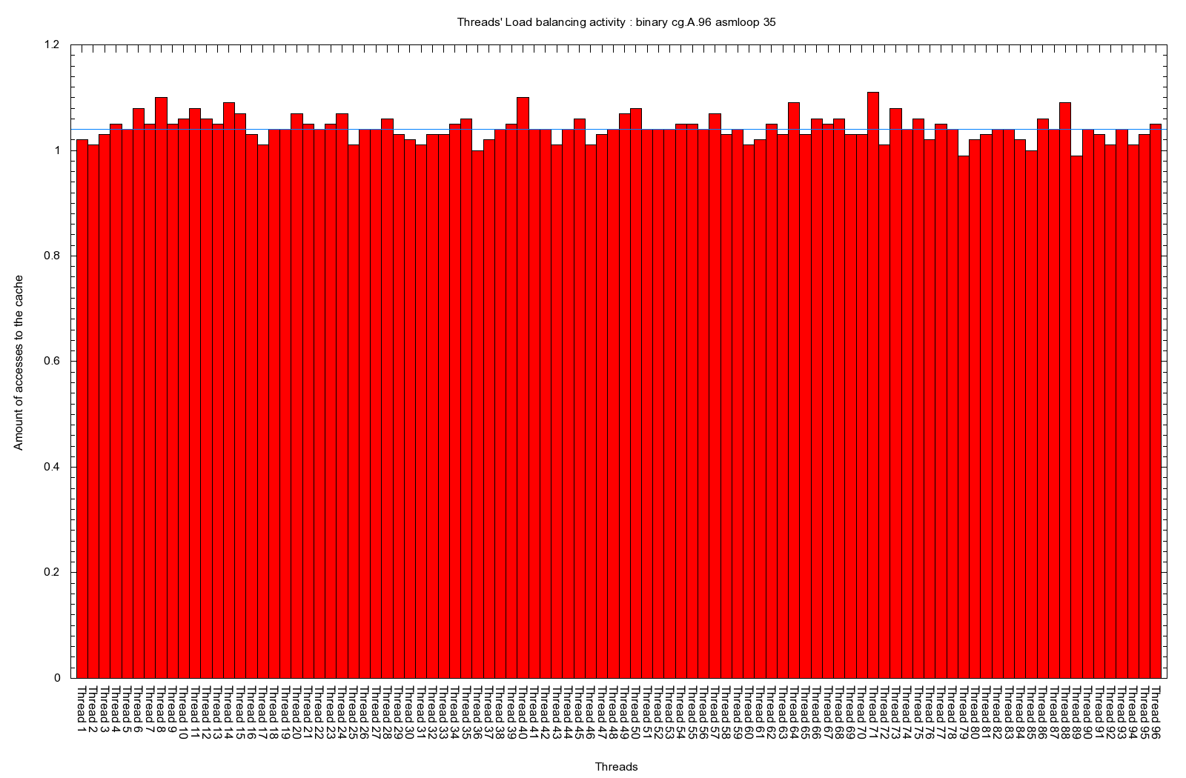
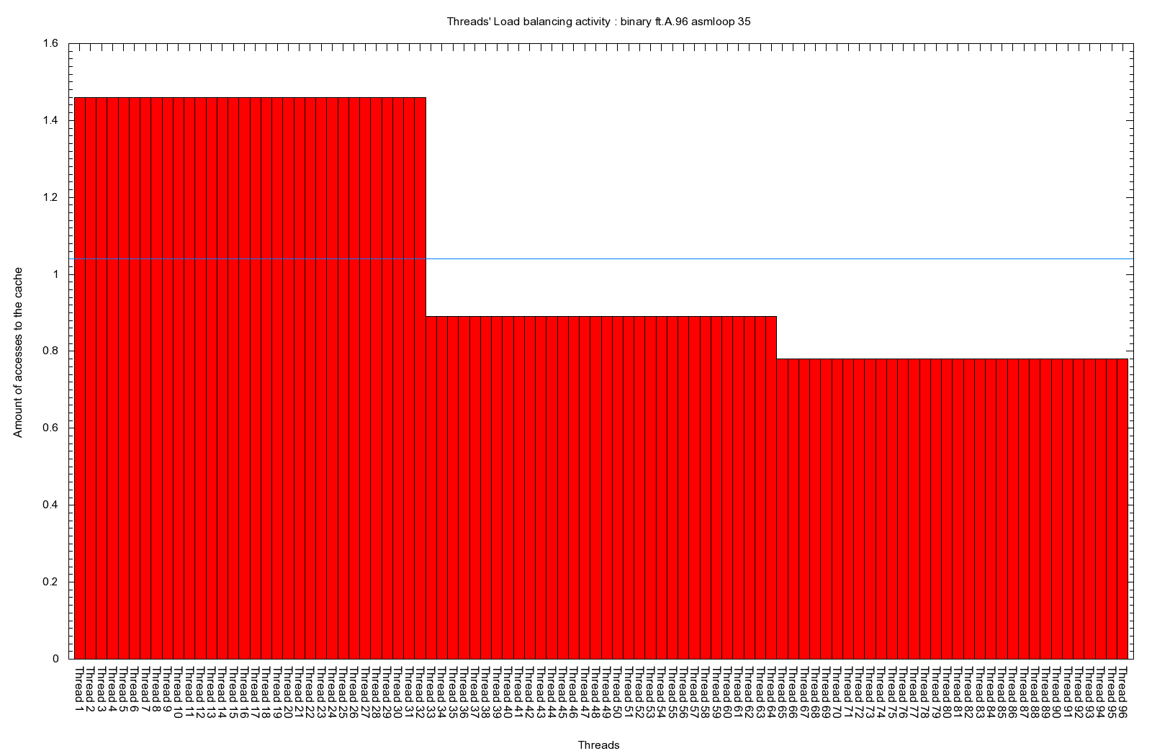
Enhancing parallelism :
Load balancing
Execution efficiency
Using all available threads is not always the best choice.
CG (left) and FT (right) NAS Parallel benchmark running on 96 Threads
% memory accesses
Thread Number
Best execution time is obtained when using 36 to 48 threads with a compact affinity.

Slide 54
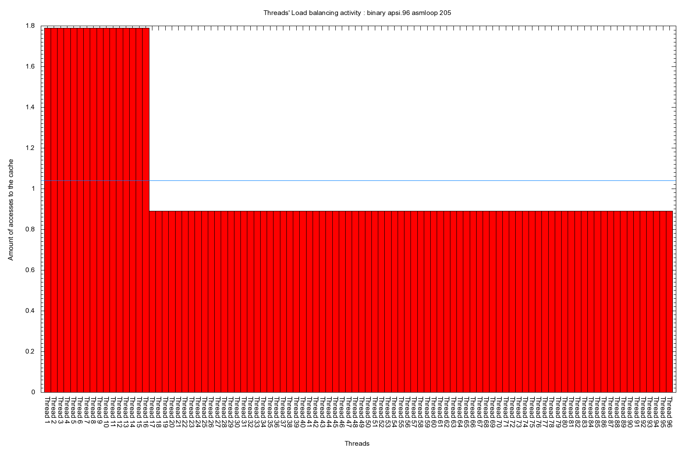
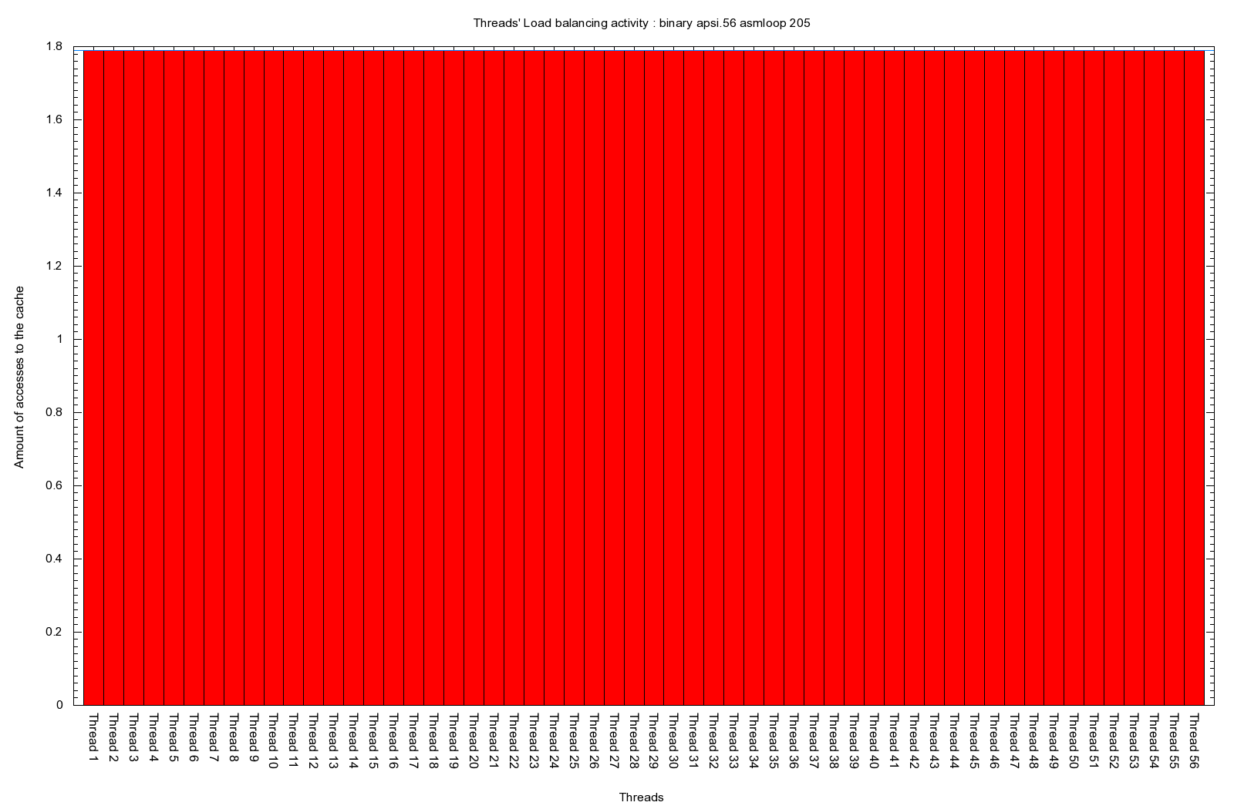
Enhancing parallelism :
Load balancing
Execution efficiency
324.APSI SpecOMP benchmark running on 96 Threads (left) and 56 Threads (right)
% memory accesses
Execution on 96 threads (left) clearly shows a load balancing issue. 16 threads do 50% more job than the others.
Best execution time obtained when using 56 threads We can observe on the right figure that the load is evenly spread among all the threads.

Slide 55
Enhancing parallelism : Model
Model
Affinity graph
  vertex : thread
  edge : cost function
    working set
    Bandwidth
    cache coherence penalties
    architecture limitations
    thresholds found thanks to microbenchmarking
Project on a (real) target architecture

Slide 56
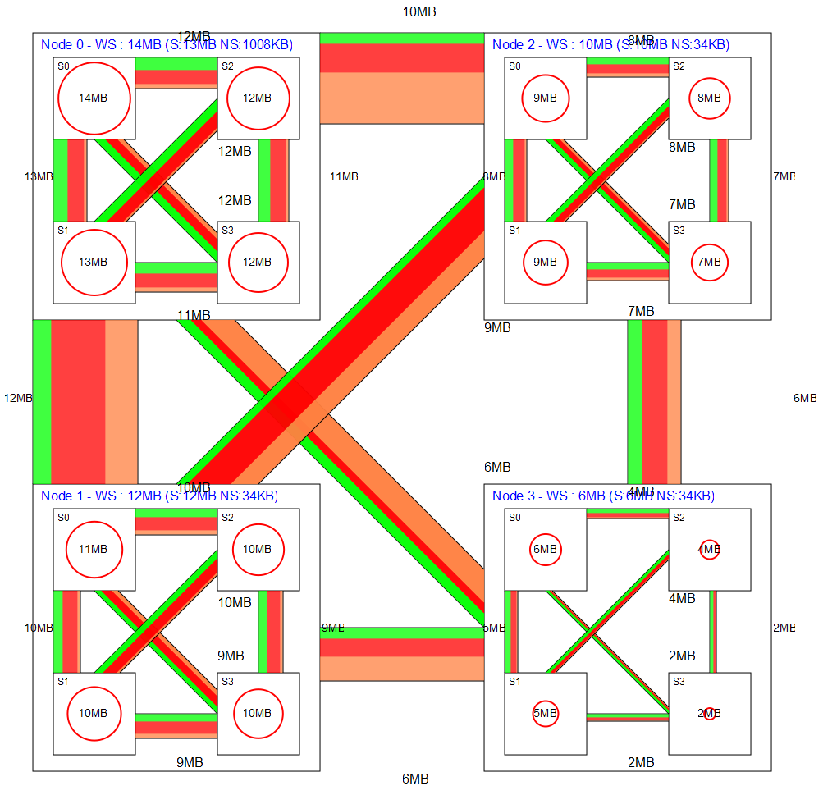
Enhancing parallelism :
Data sharing
Projection on a target architecture
Load/Load
Load/Store
Store/Store
Working set
LU decomposition application (OpenMP) on a 96 cores machine
(4 nodes – 16 sockets)
Evaluates data sharing between Nodes/Sockets :
  Working set (shared/not shared)
  Coherence based on shared cache lines (worst case)

Slide 57
Enhancing parallelism : transformations
Transformations
Swapping threads is easy
  no need to start again a simulation
  Apply a filter
Rearranging threads
  Automatically : find and swap candidates
  Let user choose
Reduce the number of thread
  Too many resource sharing issues
  Lack of parallelism (tasks)

Slide 58
Enhancing parallelism : Scaling
Scaling
Predict application behavior on next generation architectures
  Add architecture definitions
  Generate corresponding trace on existing

Slide 59
Enhancing parallelism : Results
Execution efficiency
Benchmark | Reference |  | Best / Close |  | Gain
 | WTime (s) | Threads | WTime (s) | Threads
NPB CG.A | 0.62 | 96 | 0.42 | [14-84] | 32%
NPB MG.A | 3.10 | 96 | 1.88 | [40-48] | 40%
NPB FT.A | 2.29 | 96 | 1.47 | [35-48] | 35%
SOMP 324.fma3d_m R | 117.76 | 40 | 119.15 | 32 | -1%
SOMP 320.mgrid_m R | 111.14 | 40 | 84.71 | 32 | 24%
SOMP 312.swim_m R | 122.63 | 40 | 79.22 | 32 | 35%
[] means : in the range [X to Y]

Slide 60
Hardware Performance Counters
Sampling : Finding the right sample rate !
More than 100+ counters, poor documentation
PAPI : processor events VS native events
Multiplexing (incompatible events)
User level tools
  Perf stat / top
  tiptop

Slide 61
Hardware Performance Counters
Many softwares ! Which one ? Differences ?
TAU |Scalasca |HPCToolkit | PerfSuite | Vampir | OpenSpeedShop |SvPablo |ompP
PAPI
gpfmon
User
OProfile
pfmon
likwid
Perf top
VTUNE/PTU
Kernel
OProfile
Perfmon
Perfctr
PCL
Intel Sepdk
Hardware
PMU

Slide 62
Hardware Performance Counters
Using MIL
  Selectively activate hardware counters
  Setup profiles (function, loops, etc...)
  Using :
    libperf - PCL
    PAPI - perfctr

Slide 63
Conclusion
Select a consistent methodology
Asses code quality through static analysis
Detect hotspots
Iterative approach to solve finer grain issues
If no relevant existing module : use MIL

Slide 64
Collaborations
MAQAO integrated in TAU (tau_rewrite)
Work in progress with TUM (callgrind : static intrumentation to feed a multithreaded cache simulator)
Undergoing work with Intel XE-AMPLIFIER (injecting MAQAO static analysis)

Slide 65
MAQAO Release
Not public at the moment
Official release by the end of February
Let me know if you are interested

Slide 66
Thanks for your attention !
Questions ?

